Slide 1
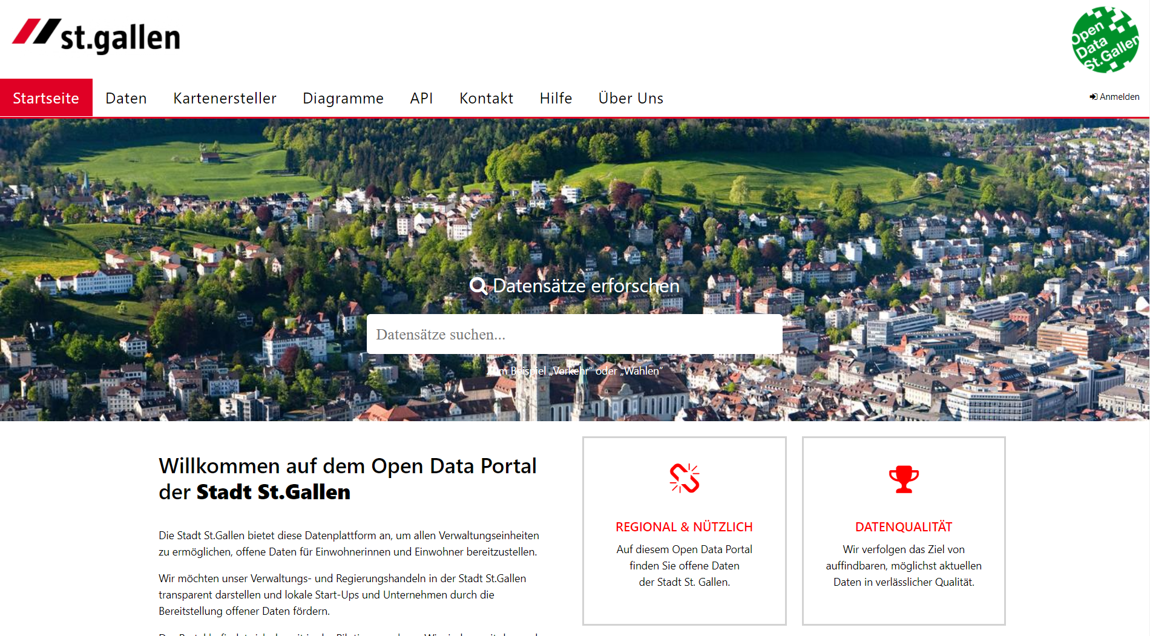

StartHack 2021 | City of St.Gallen
Dr. Christian Geiger, CDO City of St.Gallen
St.Gallen, March 19th 2021

Slide 2
ABOUT

Slide 3
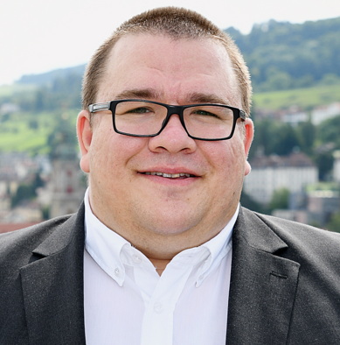
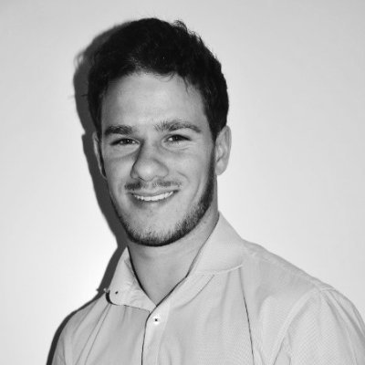
About us | City of St.Gallen
Christian Geiger
Chief Digital Officer (CDO)
Politics and Administrative Science
Open Data and Smart City activities
christian.geiger@stadt.sg.ch
+41787333031
Nicola Wullschleger
Project Manager Smart City and Open Data at City of St.Gallen
nicola.wullschleger@stadt.sg.ch

Slide 4
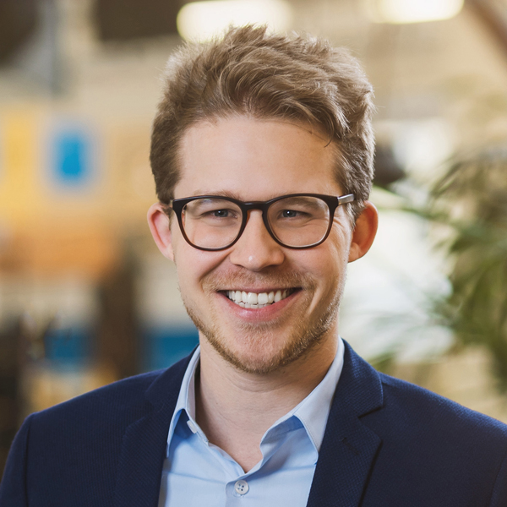
About us | Supported by Konova
Miro Hegnauer
CEO Konova AG
Owner/Managing Director
Innovative digital solutions for efficient and effective cooperation and participation processes
hegnauer@konova.ch

Slide 5
Times | Availability
In general: At most times available for meetings during Start Hack 2021.
Specifically: 100% available for Start Hack during these time slots:
Friday from 10 pm
Saturday 09 am – 10 am
Saturday 01 pm – 02 pm
Saturday 04 pm – 05 pm
Sunday 08 am – 09 am

Slide 6
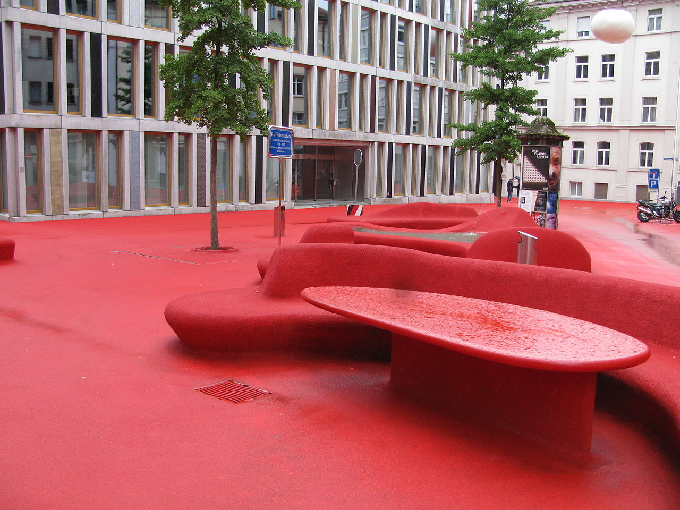
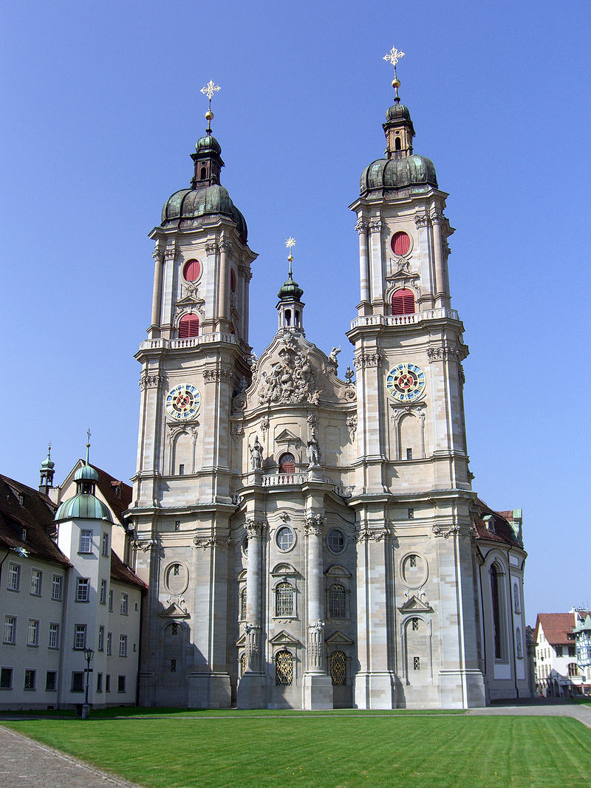

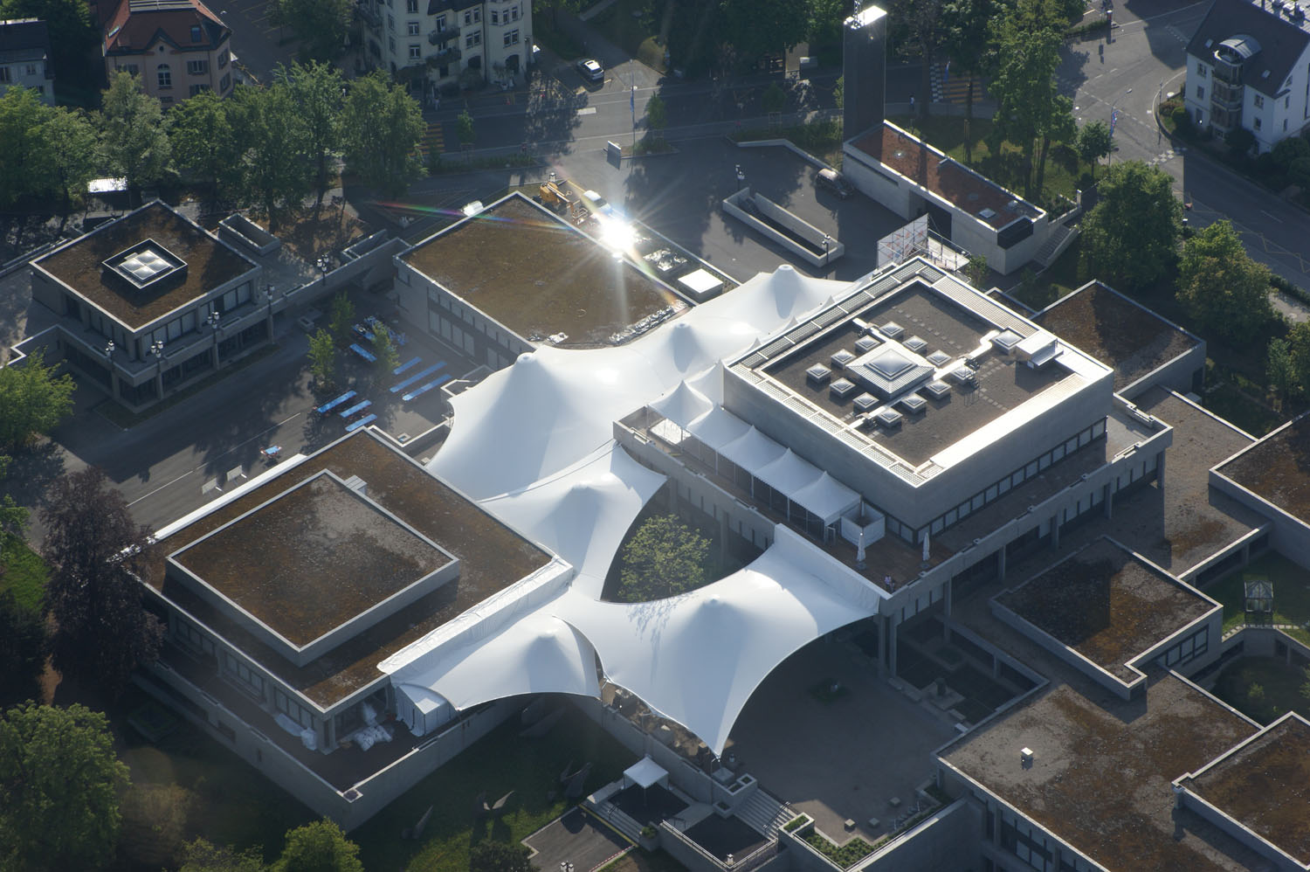
Source: ANKAWÜ, 2013, Wikipedia.
Source: Petar Marjanovic, 2007, Wikipedia
Source: Lurenz, 2013, Wikipedia
Source: International Students Committee, 2011, Wikipedia

Slide 7
About St.Gallen
Facts and Figures
Canton | St.Gallen
Spoken language | german
Inhabitants | 79’533 (as of 31 december 2018)
Organisational approach for SC Initiatives | SC as legislative target of city government for session 2017-2020 Steering committee for Smart City topics within the city administration (established 2017) Chief Digital Officer within the city administration (established 2017) Regional competence center for research, education and innovation (“Smart City Lab”)
Digital Infrastructure and Layer | fully developed city-wide FTTH network, provided by municipal public services (2009-2019) 4G infrastructure selective LoRaWAN infrastructure within the city, provided by St.Galler Stadtwerke (sgsw)

Slide 8
SMART CITY

Slide 9
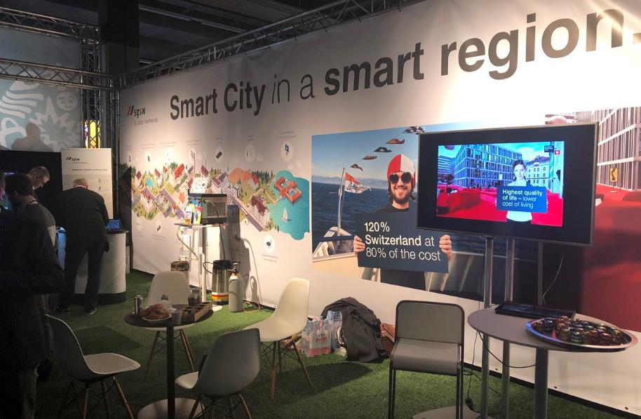

Slide 10
«Smart City»
Definition
"In a smart city, technologies and data are linked to increase the quality of life for residents and the quality of location for businesses, while using less resources. Residents are an essential part of the developments and can develop, test and co-determine solutions for everyday life. “
St.Gallen, September 2018

Slide 11
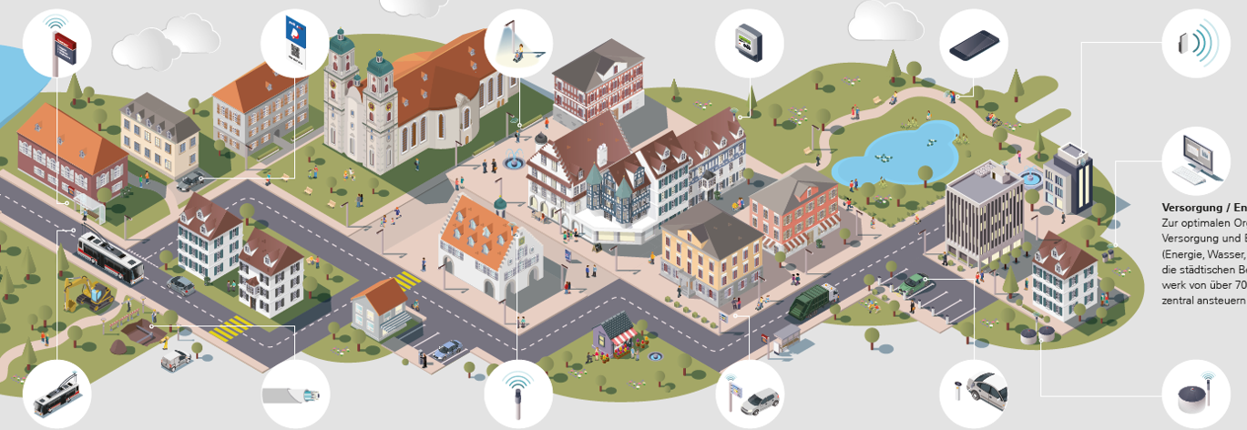
Activities
Notes:
Smartnet
Smart quarters
Smart Parking
Local App
City Detector
Chatbot
OpenData
Social Networks
Start-Up

Slide 12
Specific Projects
Smart districts: Districts serve St.Gallen to pioneer its SC-projects: While the „Remishueb“-district is adapting SC-applications in an existing, grown district, a greenfield-strategy is being pursued in the new housing estate „Sturzenegg“. In both districts, innovations are being developed in collaboration with the residents. Status: in use; Partner: Municipal public Services of the City of St.Gallen
Testfeld St.Gallen: In order to test prototypical SC-applications administration, science and local business provide infrastructure and know-how for innovation, thereby promoting the establishment of new companies and start-ups. Status: in implementation; Partner: City Administration and different partners
Internet of Things (IoT): 70 outdoor facilities within the city are equipped with low-radiation sensors. This allows municipal city services to control and monitor various applications in the sector of mobility, energy and infrastructure to help reduce waste, light & transport emissions. Status: in use; Partner: Municipal public Services of the City of St.Gallen and different partners
Smart Parking: Sensors detect free parking spots, report these via low-radiation technology and support the data for navigation systems and apps. Smart parking systems help to avoid search traffic and reduce energy consumption as well as air pollution. Status: prototype in use 2017-2019; Partner: city police

Slide 13
Specific Projects
Local App: Residents of pilot districts „Sturzenegg“ and „Remishueb“ are using an app to inform, exchange or organize themselves. The city helps to develop further neighbourhood apps. Status: in use since 2016, new prototype in use 2019-2020, Partner: anthrazit
City Detector: St.Gallen’s city app allows every user to report on public infrastructure. Thanks to the city detector, the city administration is able to react straightforward and maintain an immediate dialogue with individual citizens. Status: in use; Partner: anthrazit; Remarks: » www.stadtmelder.stadt.sg.ch
Chatbot: The city of St.Gallen has deployed a chatbot application for its citizens. It is a messenger service that provides 24/7 access to city administration information and services through an automated text dialog. Status: prototype in use 2019; Partner: Abraxas, Byerley; Remarks: Promoted as „Innovation 2018/2019” by eGovernment Switzerland
Open Data: St.Gallen promotes the provision of „Open Data“ on its own platform based on selected accessible records of the city administration. Status: prototype in use 2019; Partner: OpenDataSoft, Canton of St.Gallen
Network for innovation: „Startfeld“ and „Smartfeld“ form the center of a targeted innovation and youth development. “Startfeld” offers funding opportunities for startups and established SMEs that launch innovations. Additionally the project “Smartfeld” provides students with first contacts with the digitised working world in order to create digital skills as an investment in the future. Status: in use; Partner: Partner Network; Remarks: » www.startfeld.ch; » www.smartfeld.ch

Slide 14
YOUR CHALLENGE

Slide 15
Challenge | Why? | current challenges fo cities
More sustainability
Social
Ecological
Economical
General Digitalization
Requested more efficiency
Covid 19
Less financial ressources
competition (other cities)
More Participation
Skills shortage

Slide 16
Your mission | Your challenges
Milestone 1
Making a proposal (PoC) for a tool on how to involve the population in participatory budgeting.
Milestone 2
Develop a proposal (PoC) for action on how participation on savings suggestions might look like.
Solution can be a prototyped or coded analysis and partizipation tool to identify potential savings and to publicly collect these inputs in a partizipative manner.

Slide 17
Challenge | Principles | Scope of Action | major challenges
Present context of costs e.g. you can’t save money for upkeeping the street without getting more potholes - show dependencies between expenses and product quality / citizens satisfaction
dealing with the complexity of budget data (reduce complexity/usability)
Ideally (but not mandatory) integration to the existing digital participation plattform (Konova)

Slide 18
Challenge | Principles
Transparency to budget data
Participatory budgeting
Benchmarking to other cities
Using wisdom of the crowds (participation of people) to save money and/or spend it to favored citizens projects
Enabling people to participate for their own cities budget

Slide 19
POSSIBLE IDEAS FROM OTHER PLACES

Slide 20
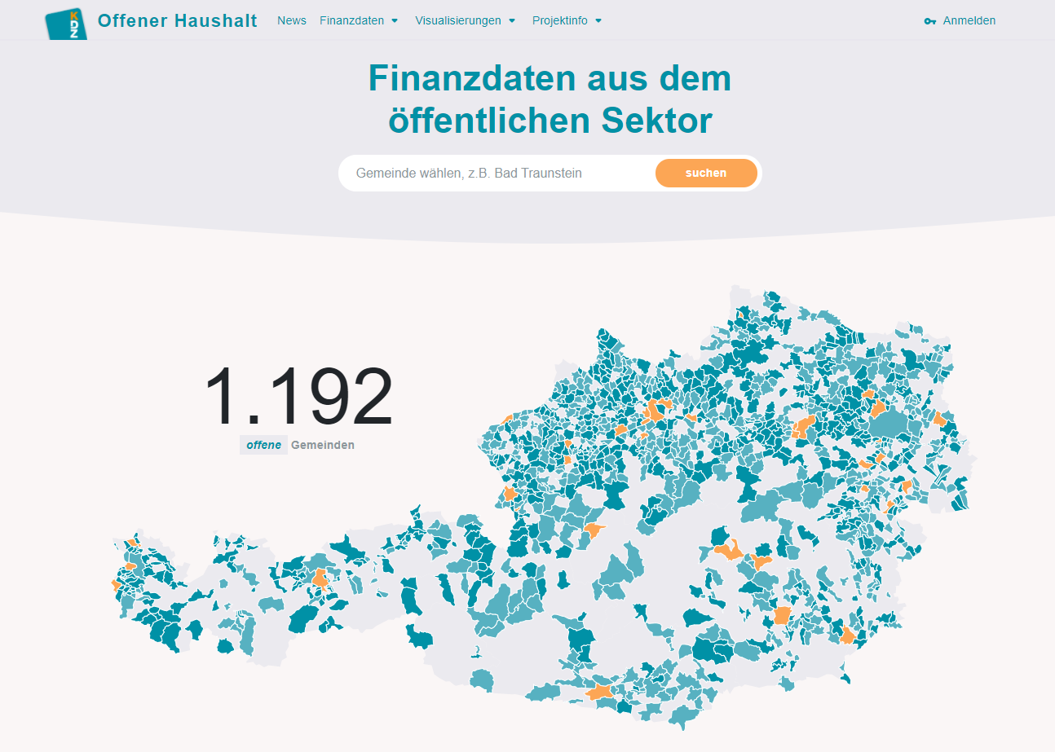
Offenerhaushalt.at

Slide 21
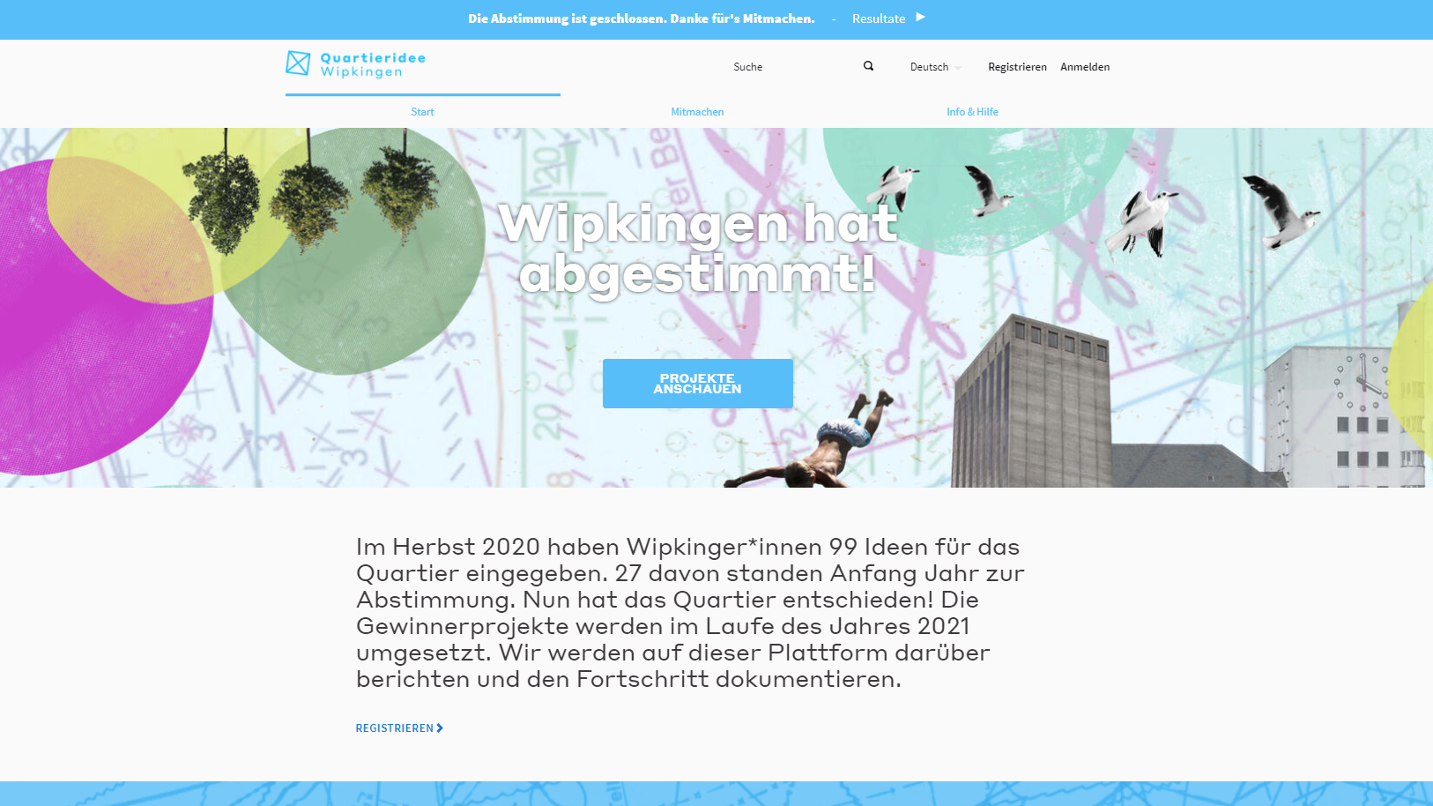
Quartieridee.ch | Wipkingen

Slide 22
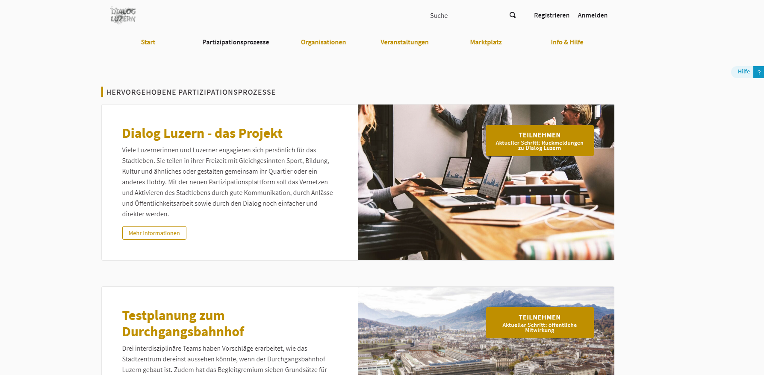
Dialogluzern.ch

Slide 23
CURRENT ACTIVITIES AND DATA

Slide 24
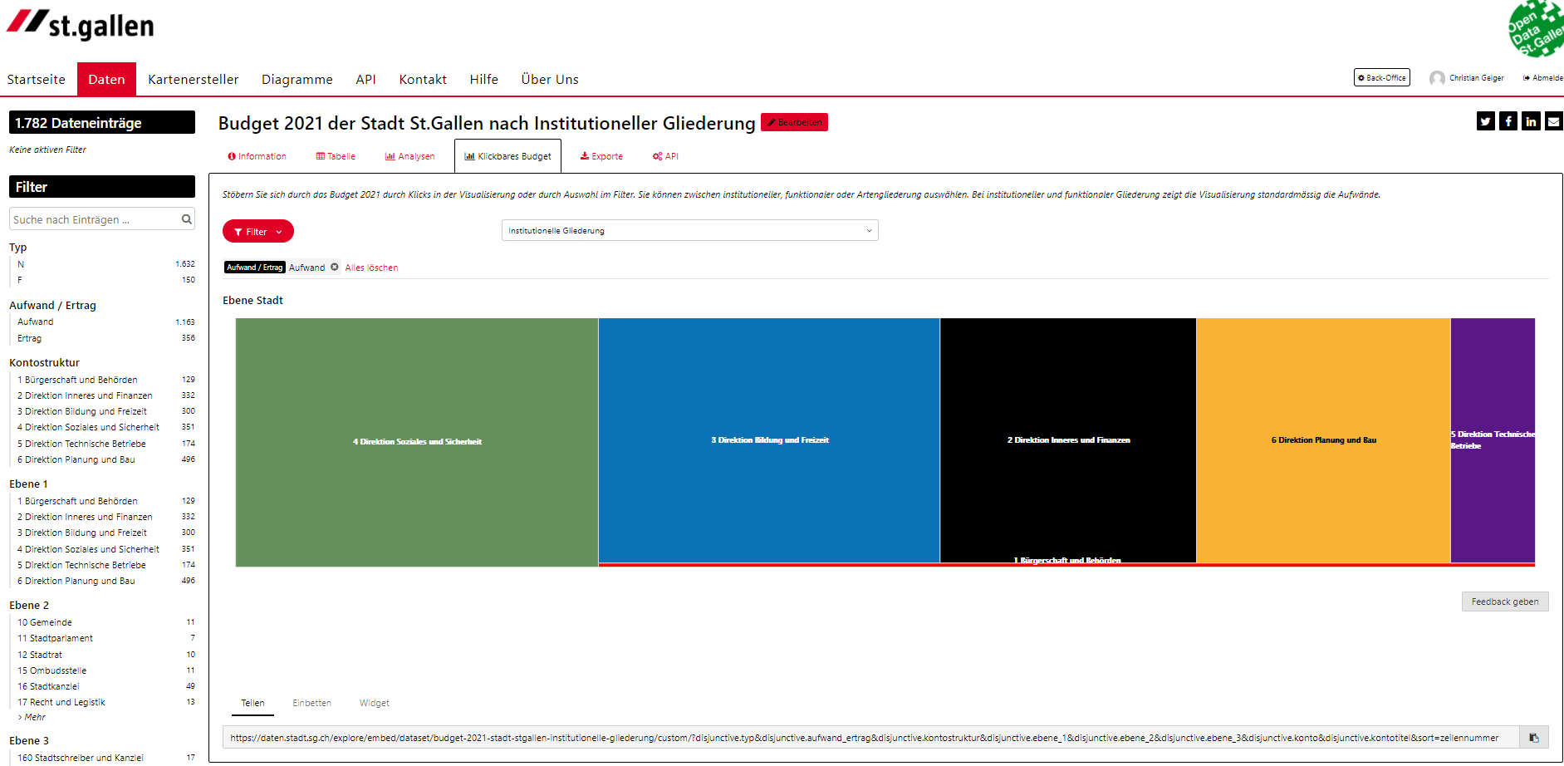
Open Data Soft | Budget Data 2021 | City of St.Gallen
Source: Budget 2021 der Stadt St.Gallen nach Institutioneller Gliederung — St.Gallen (sg.ch)

Slide 25
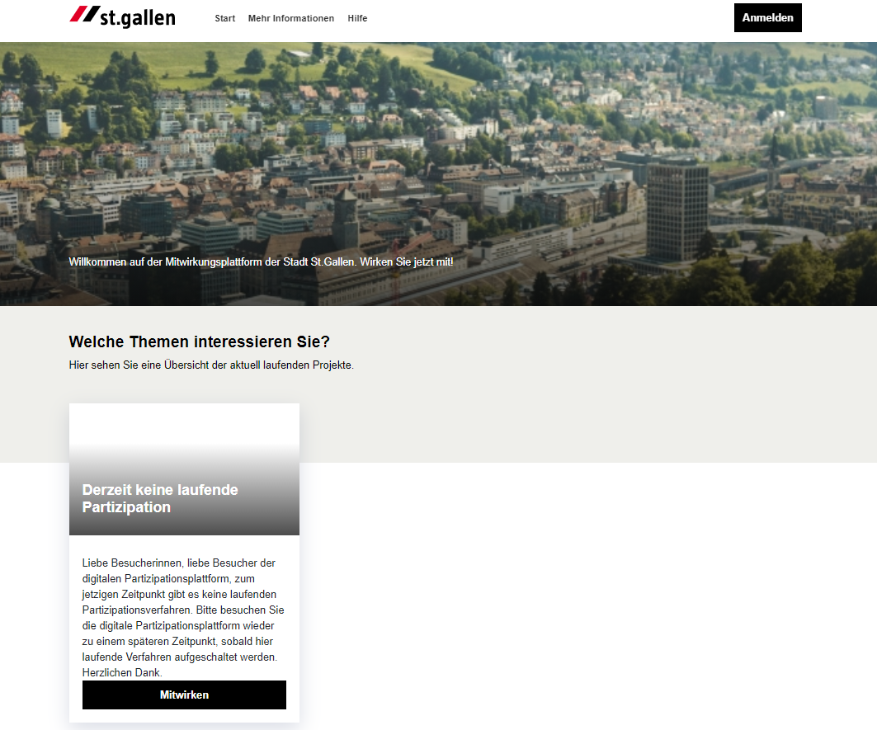
Digital Participation Plattform | Konova | https://partizipieren.stadt.sg.ch/de/
Current Participation possibilities in
Texts
Maps
Comments
…

Slide 26

Open Data Soft | Budget Data 2021 | City of St.Gallen
Source:
https://daten.stadt.sg.ch/explore/?sort=modified&disjunctive.modified&disjunctive.theme&disjunctive.keyword&disjunctive.publisher&q=english+data

Slide 27
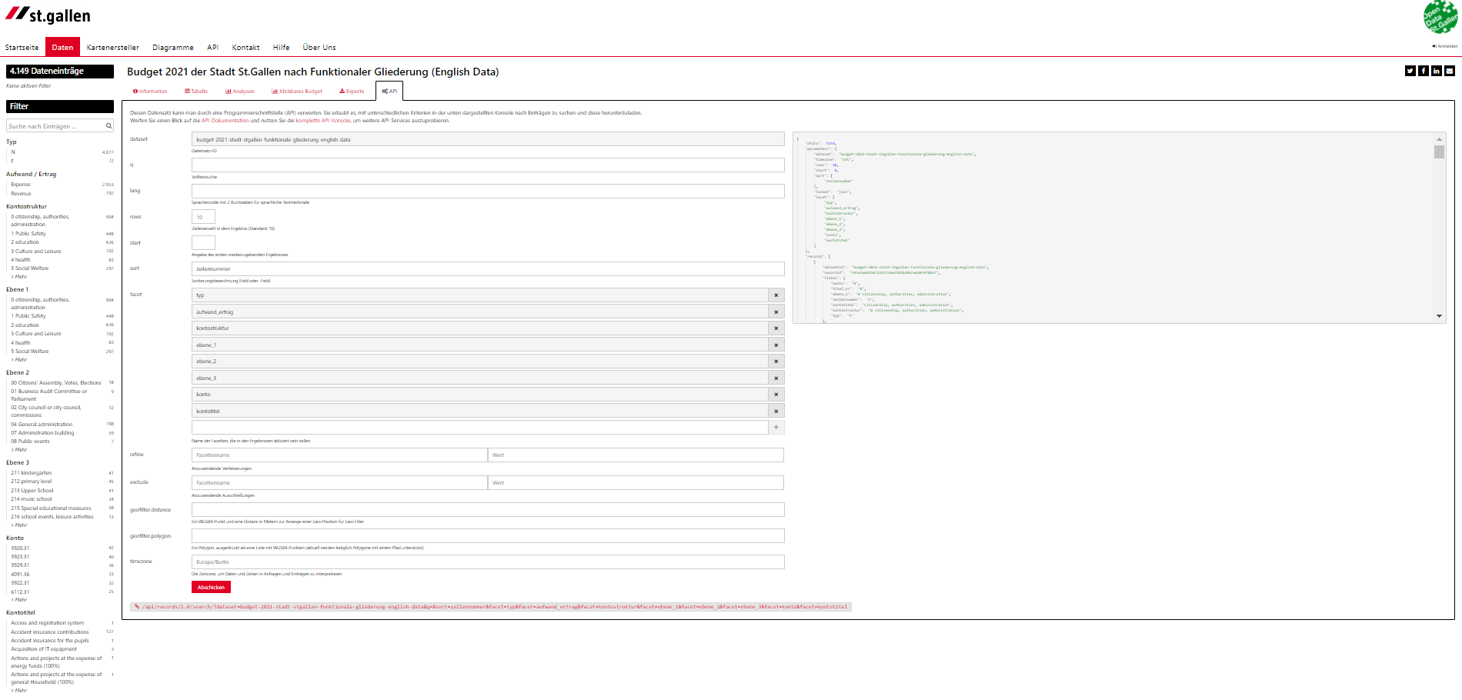
Open Data Soft | Budget Data 2021 | City of St.Gallen
Rest-API
Possibility to embed graphics
….
https://daten.stadt.sg.ch/explore/dataset/budget-2021-stadt-stgallen-funktionale-gliederung-english-data/api/?disjunctive.typ&disjunctive.aufwand_ertrag&disjunctive.kontostruktur&disjunctive.ebene_1&disjunctive.ebene_2&disjunctive.ebene_3&disjunctive.konto&disjunctive.kontotitel&sort=zeilennummer

Slide 28
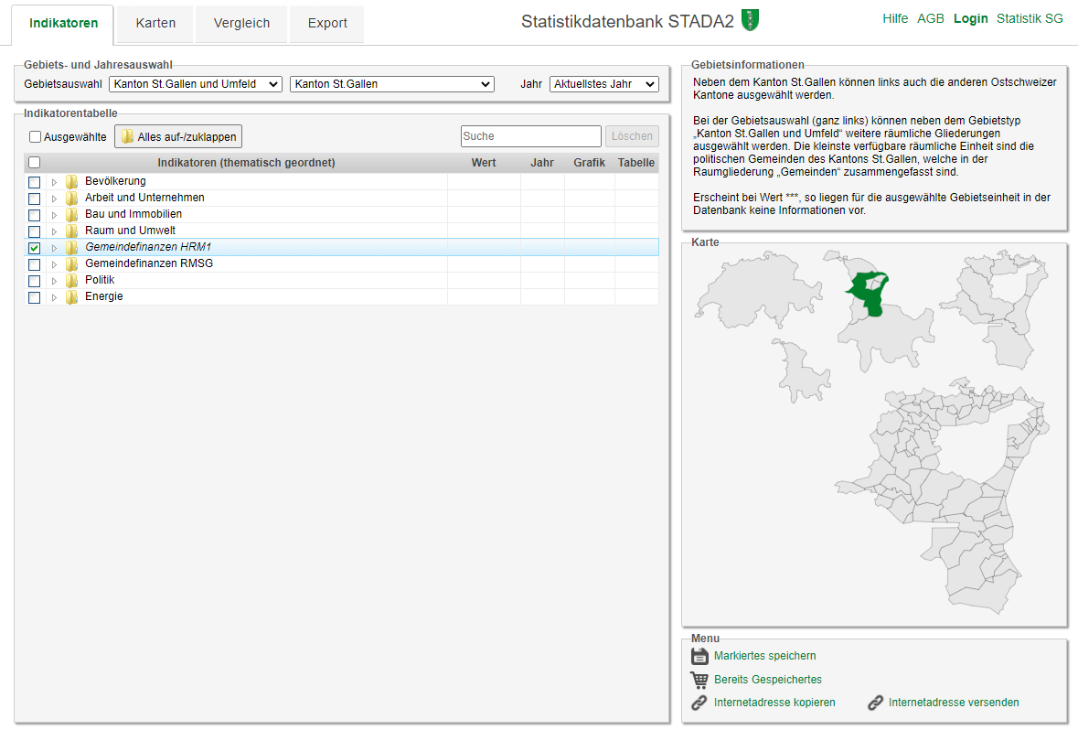
Open Data Soft | Budget Data 2021 | stada2.sg.ch
Source: https://stada2.sg.ch/

Slide 29
Links to Data Sources
01 GitHub Repository of the City for the Hack: https://github.com/CityofStGallen/START-Hack-2021
02 Open Data Portal for the City of St.Gallen: https://daten.stadt.sg.ch/pages/home0/
03 Open Data Portal City St.Gallen – Budget Data (english): https://daten.stadt.sg.ch/explore/?sort=modified&disjunctive.modified&disjunctive.theme&disjunctive.keyword&disjunctive.publisher&q=english+data
04 Statistics Budget Data (Translated Metadata) (Source stada2): https://github.com/CityofStGallen/START-Hack-2021/blob/main/04_stada2_metainfo_gemeindefinanzen.csv
For Data see 11a or 11b; also other cities available!
05 Metadata template (proposal) for suggested savings: https://github.com/CityofStGallen/START-Hack-2021/blob/main/05_Metadata%20template%20(proposal)%20for%20suggested%20savings.xlsx
06 Statistics Portal Kanton SG (including other structural data like age etc.): http://stada2.sg.ch/
07 National OGD Portal (opendata.swiss): https://opendata.swiss/de
08 Open Data St.Gallen (Canton): https://daten.sg.ch/pages/home0/
09 Statistics Portal City SG: https://www.stadt.sg.ch/home/verwaltung-politik/stadt-zahlen/statistiken-finden.html

Slide 30
Further Links
10 Finances Canton St.Gallen: https://www.sg.ch/steuern-finanzen/finanzen/finanzpublikationen.html
11 Finances Municipalities: https://www.sg.ch/politik-verwaltung/gemeinden/gemeindefinanzen.html
11a In Statistics Portal: http://stada2.sg.ch/
11b In Open Data Portal: https://daten.sg.ch/explore/?refine.keyword=Gemeindefinanzen&disjunctive.modified&disjunctive.dcat.creator&disjunctive.theme&disjunctive.keyword&sort=modified
The usage and automatic integration of datasets is highly recommended
For a possible integration in the participation portal we can offer you a test account for a participative process

Slide 31
Possible Ideas from other cities / countries
What do we want?
Recommendations for expenses and/or
ideas for sustainable participation in budget
Some ideas and/or examples
«click your own budget – do your own savings»
Compare timelines and/or cities expenses
Brainstorming for Budgeting
YOUR IDEA AND SOLUTION

Slide 32
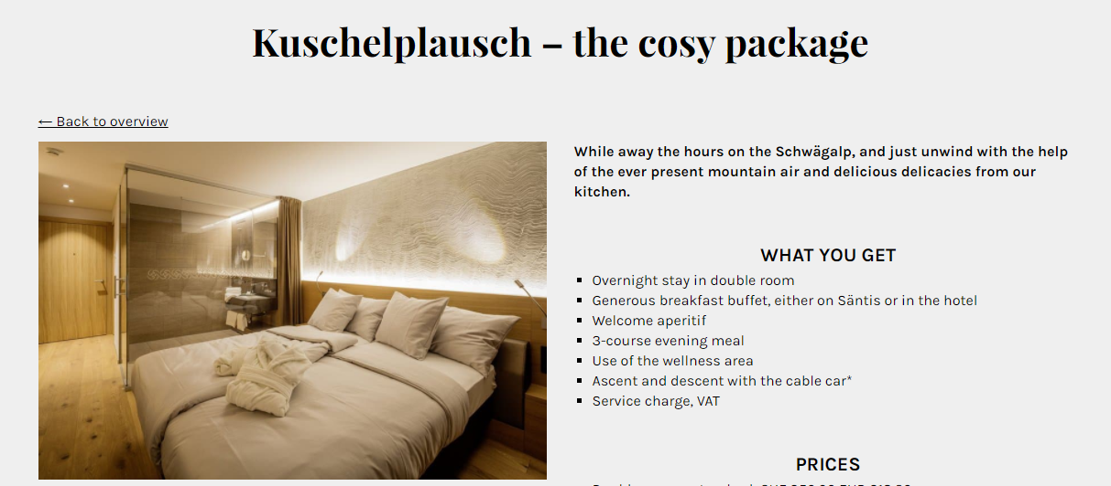
Prices

Slide 33
Judging Criteria
Complexity & Technical Sophistication Usage of appropriate services and technologies
Design Usability of the solution
Viability Possibility of realizing the solution
Feasibility Maturity Level of the developed solution
Creativity & Innovation surprise effect to the jury
Presentation Communication of the developed solution

